Slide 1
Introduction to Neural Networks & Machine Learning
Almaz Turginbekov
MSc in Computer Science and Engineering
Graduate School of Science and Technology
Niigata University
Teacher East-Kazakhstan Technical University

Slide 2
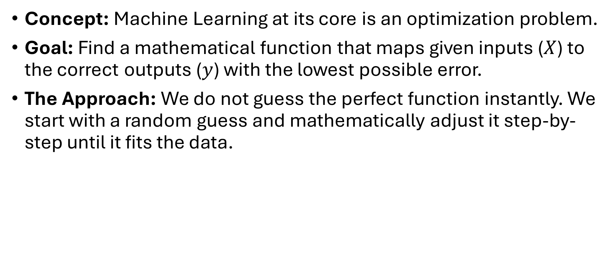
The Core Objective of Machine Learning
Concept: Machine Learning at its core is an optimization problem.
Goal: Find a mathematical function that maps given inputs ($X$) to the correct outputs ($y$) with the lowest possible error.
The Approach: We do not guess the perfect function instantly. We start with a random guess and mathematically adjust it step-by-step until it fits the data.

Slide 3
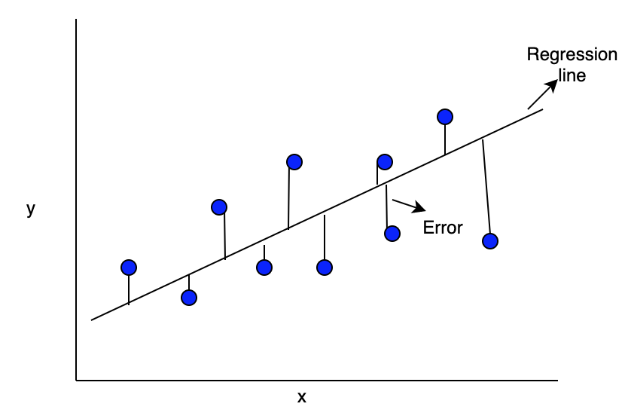
Linear Regression - The Foundation
Definition: A linear approach to modeling the relationship between a dependent variable and one or more independent variables.
Visual Representation: Drawing a single, straight line through a scatter plot of data points that best captures the overall trend.
Use Cases: Predicting continuous numerical values (e.g., house prices, temperature forecasts, engine wear levels).

Slide 4
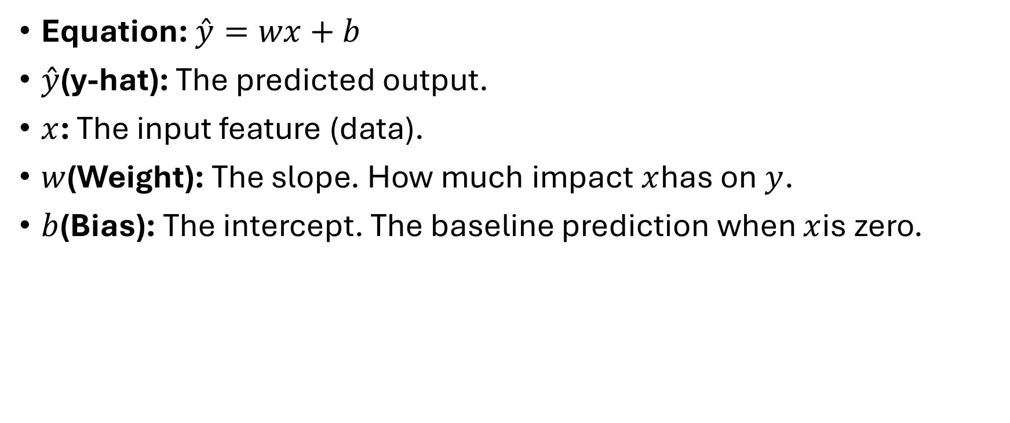
The Fundamental Equation
Equation: $\overset{ˆ}{y}=wx+b$
$\overset{ˆ}{y}$(y-hat): The predicted output.
$x$: The input feature (data).
$w$(Weight): The slope. How much impact $x$has on $y$.
$b$(Bias): The intercept. The baseline prediction when $x$is zero.

Slide 5
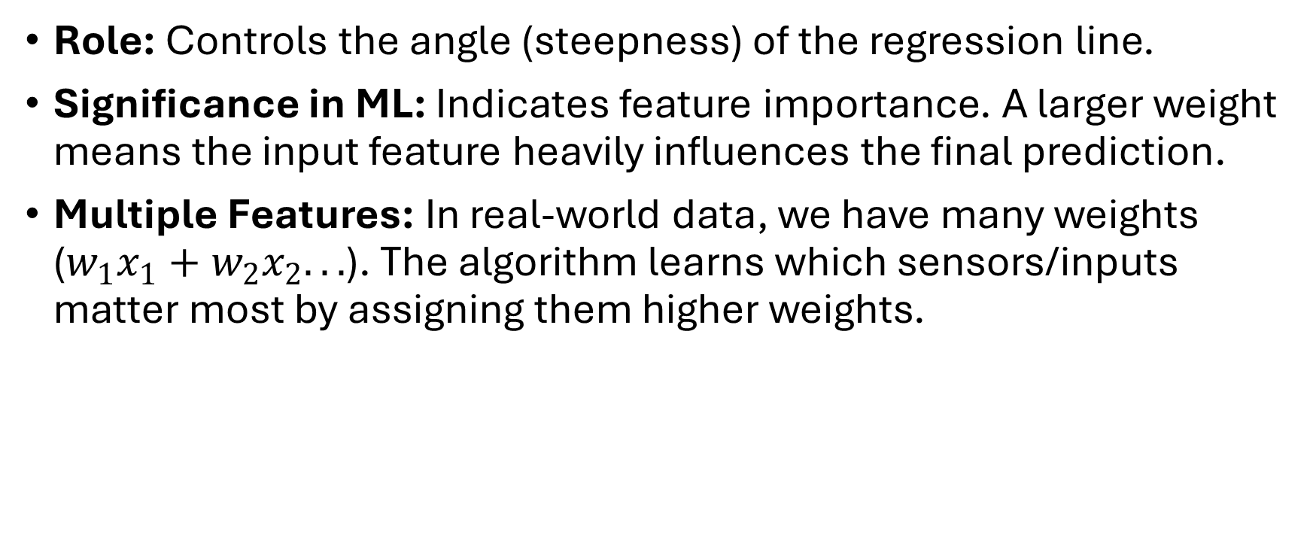

Understanding Weights ($w$)
Role: Controls the angle (steepness) of the regression line.
Significance in ML: Indicates feature importance. A larger weight means the input feature heavily influences the final prediction.
Multiple Features: In real-world data, we have many weights ($w_{1}x_{1}+w_{2}x_{2}...$). The algorithm learns which sensors/inputs matter most by assigning them higher weights.

Slide 6
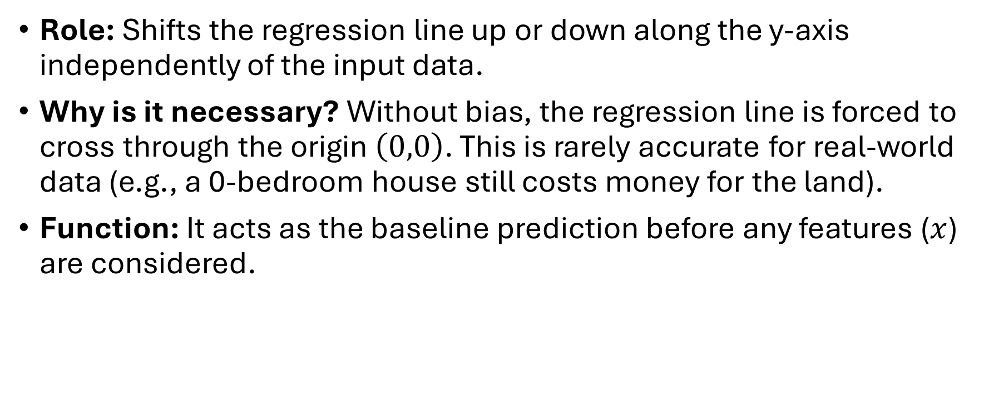

Understanding Bias ($b$)
Role: Shifts the regression line up or down along the y-axis independently of the input data.
Why is it necessary? Without bias, the regression line is forced to cross through the origin $\left(0,0\right)$. This is rarely accurate for real-world data (e.g., a 0-bedroom house still costs money for the land).
Function: It acts as the baseline prediction before any features ($x$) are considered.

Slide 7
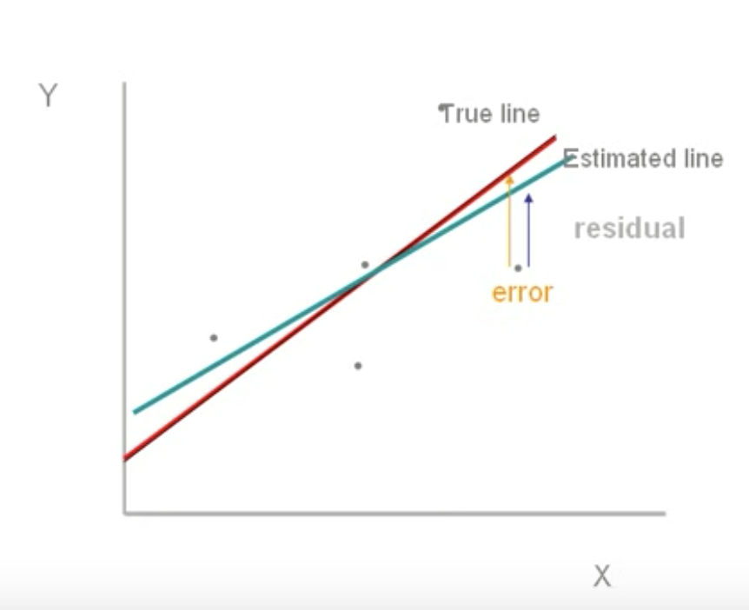
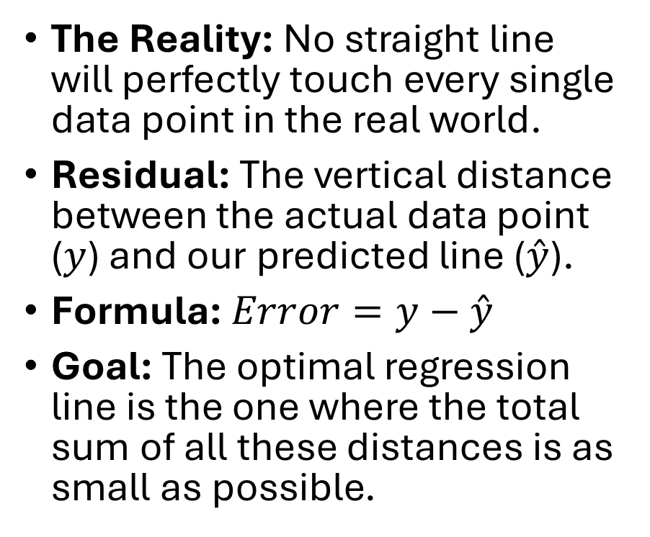
The Concept of Error (Residuals)
The Reality: No straight line will perfectly touch every single data point in the real world.
Residual: The vertical distance between the actual data point ($y$) and our predicted line ($\overset{ˆ}{y}$).
Formula: $Error=y−\overset{ˆ}{y}$
Goal: The optimal regression line is the one where the total sum of all these distances is as small as possible.

Slide 8
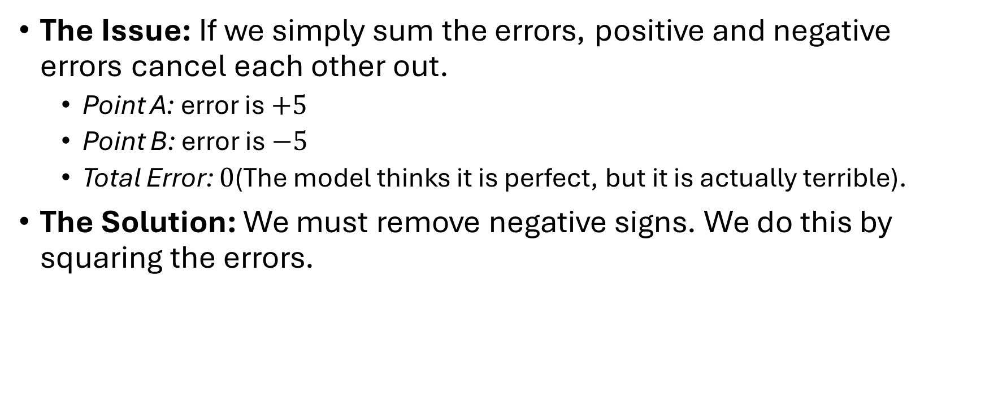
The Problem with Simple Error
The Issue: If we simply sum the errors, positive and negative errors cancel each other out.
  Point A: error is $+5$
  Point B: error is $−5$
  Total Error: $0$(The model thinks it is perfect, but it is actually terrible).
The Solution: We must remove negative signs. We do this by squaring the errors.

Slide 9
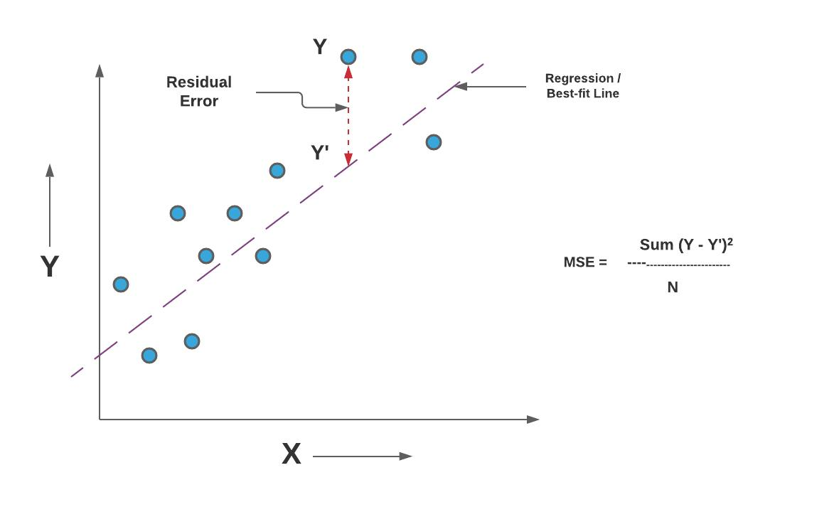
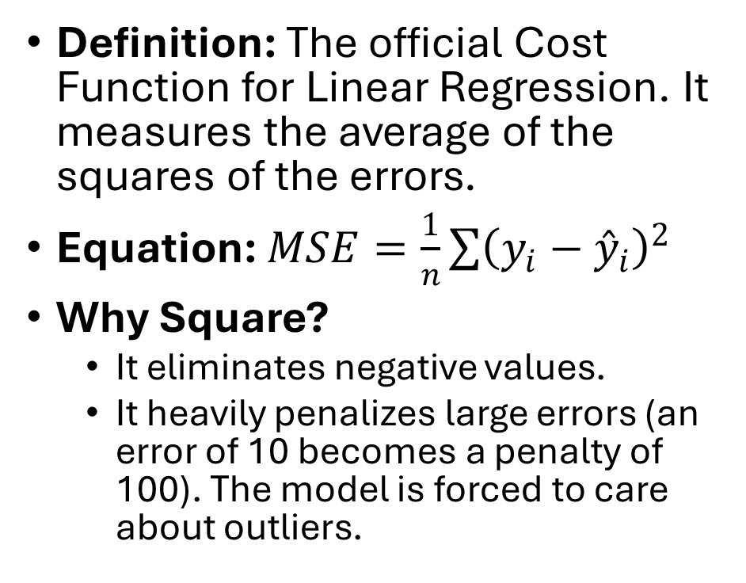
Mean Squared Error (MSE)
Definition: The official Cost Function for Linear Regression. It measures the average of the squares of the errors.
Equation: $MSE=\frac{1}{n}\sum{{\left(y_{i}−{\overset{ˆ}{y}}_{i}\right)}^{2}}$
Why Square?
  It eliminates negative values.
  It heavily penalizes large errors (an error of 10 becomes a penalty of 100). The model is forced to care about outliers.

Slide 10
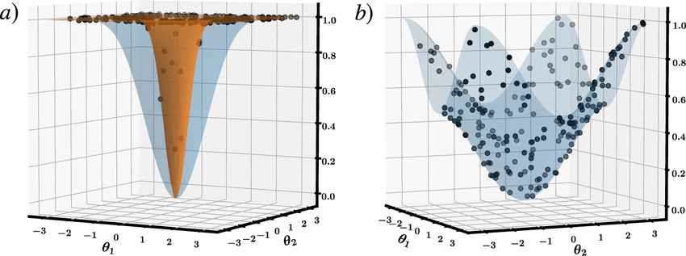
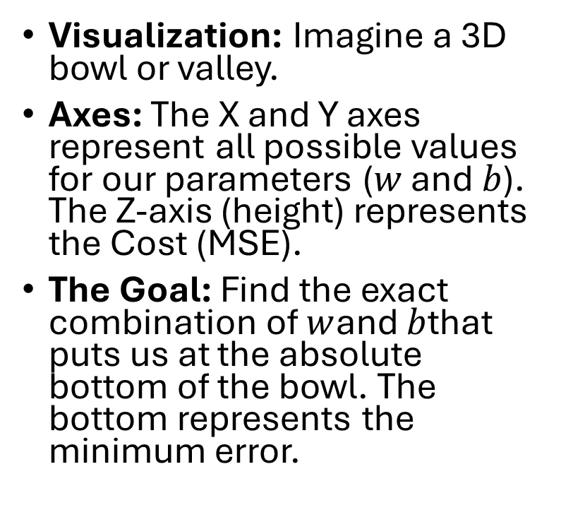
The Cost Function Landscape
Visualization: Imagine a 3D bowl or valley.
Axes: The X and Y axes represent all possible values for our parameters ($w$ and $b$). The Z-axis (height) represents the Cost (MSE).
The Goal: Find the exact combination of $w$and $b$that puts us at the absolute bottom of the bowl. The bottom represents the minimum error.

Slide 11
How to Find the Bottom?
Analytical Approach (Normal Equation): Solving for the bottom using pure algebra. Works for small datasets but computationally crashes on massive data with millions of features.
Algorithmic Approach (Gradient Descent): An iterative, step-by-step optimization algorithm. Highly scalable and the foundation of all Deep Learning.

Slide 12
Gradient Descent - The Concept
Analogy: Imagine being blindfolded on a mountain and trying to reach the lowest valley.
The Strategy:
  Feel the slope of the ground beneath your feet.
  Take a step downhill (in the opposite direction of the upward slope).
  Repeat until the ground is completely flat (slope = 0).

Slide 13
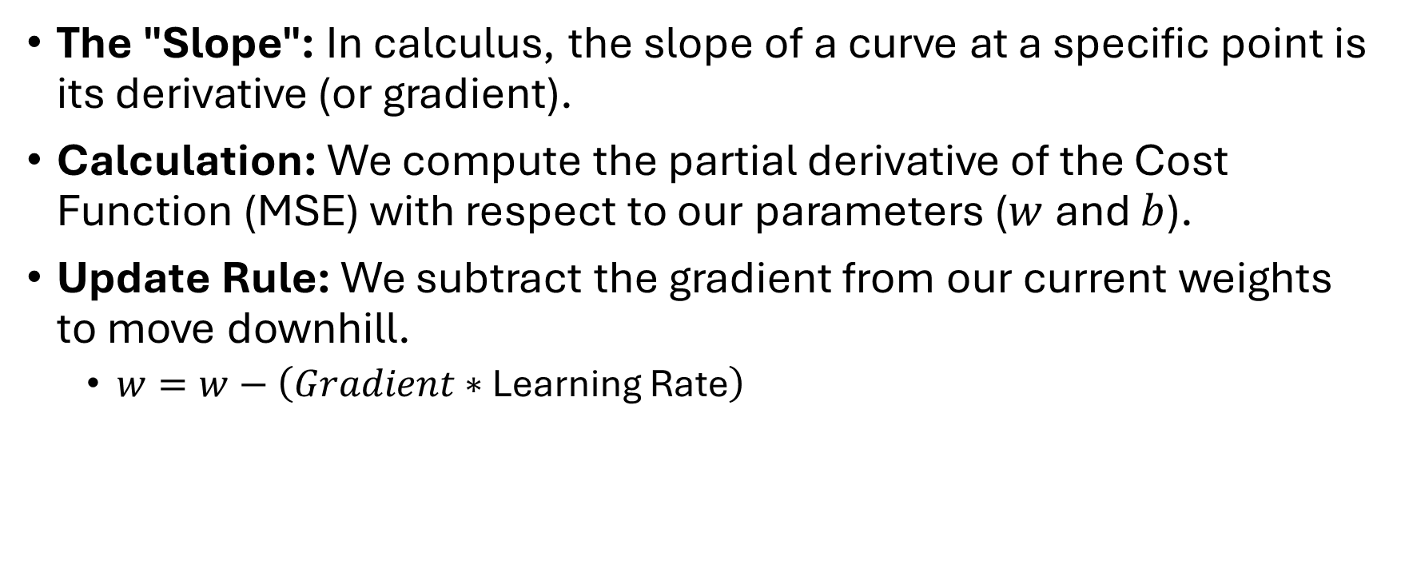
Gradient Descent - The Mathematics
The "Slope": In calculus, the slope of a curve at a specific point is its derivative (or gradient).
Calculation: We compute the partial derivative of the Cost Function (MSE) with respect to our parameters ($w$ and $b$).
Update Rule: We subtract the gradient from our current weights to move downhill.
  $w=w−\left(Gradient∗\text{Learning Rate}\right)$

Slide 14

The Learning Rate ($α$)
Definition: A hyperparameter that controls the size of the step we take downhill during Gradient Descent.
If too small: The algorithm takes tiny steps. It will eventually reach the minimum, but training will take days or weeks.
If too large: The algorithm takes massive steps. It will overshoot the valley, bounce across the walls, and diverge (error goes to infinity).

Slide 15
Epochs and Iterations
Epoch: One complete pass of the entire training dataset through the algorithm.
Batch: We rarely calculate the gradient on the entire dataset at once (too heavy for RAM). We split data into batches.
Iteration: One update of the model's weights. If we have 1000 rows, and a batch size of 100, one epoch requires 10 iterations.

Slide 16
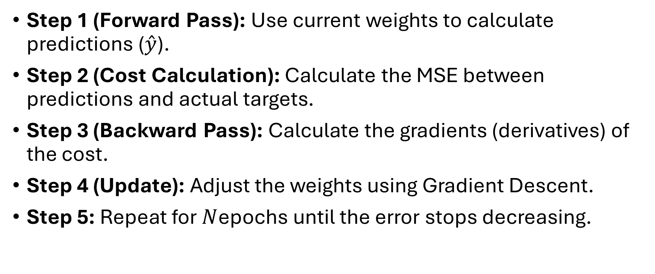
Putting It All Together (The Loop)
Step 1 (Forward Pass): Use current weights to calculate predictions ($\overset{ˆ}{y}$).
Step 2 (Cost Calculation): Calculate the MSE between predictions and actual targets.
Step 3 (Backward Pass): Calculate the gradients (derivatives) of the cost.
Step 4 (Update): Adjust the weights using Gradient Descent.
Step 5: Repeat for $N$epochs until the error stops decreasing.

Slide 17
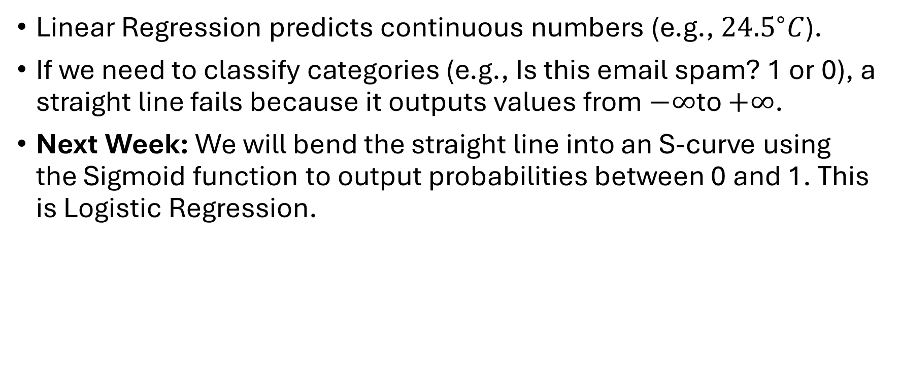
From Linear to Logistic (Looking Ahead)
Linear Regression predicts continuous numbers (e.g., ${24.5}^{∘}C$).
If we need to classify categories (e.g., Is this email spam? 1 or 0), a straight line fails because it outputs values from $−∞$to $+∞$.
Next Week: We will bend the straight line into an S-curve using the Sigmoid function to output probabilities between 0 and 1. This is Logistic Regression.

